Slide 1

DATA ANALYSIS- SALES REVENUE ANALYSIS
NAME-SAMAD SULTAN RIZWAN KHATRI.

Slide 2
INTRODUCTION
The "Yearly Revenue 2020 ($000's)" column quantifies the financial performance of each product with respect to revenue generation. This annual revenue figure is presented in thousands of dollars, giving an overview of the monetary impact of each product.
this dataset serves as a valuable asset for businesses aiming to derive insights and patterns from their operations.
By analyzing these columns, companies can gain insights into product performance, client engagement, revenue distribution, and market presence.
TO evaluate the impact of the store on customer experience and satisfaction BY understanding customer preferences.

Slide 3
SUM OF SALES CATEGORY WISE
THE MOST SALES IS DONE BY BRONZE CATEGORY OF CLIENTS WHICH IS 242.7M, AND THE LEAST SALES DONE BY IS GOLD CATEGORY OF CLIENTS WHICH IS 137.6M.
BASED ON THE DATA ABOVE IT IS BEST TO CONCENTRATE ON GOLD CATEGORY CLIENTS BY CAPTURING CUSTOMERS ATTENTION AND PERSUAING THEM TO BUY MORE.

Slide 4
COUNT OF CLIENTS COUNTRY WISE
AS SHOWN IN THE FIGURE MOST OF THE CLIENTS ARE IN KOREA THAT IS 14,514 AND THE LEAST CLIENTS ARE IN AUSTRALIA THAT IS 14,054.
ALMOST ALL OF THE COUNTRIES HAVE EQUAL AMOUNT OF CLIENTS.

Slide 5
QUARTELRY SALES COUNTRY WISE
THE HIGHEST SALE IS IN THE LAST QUARTER OF THE YEAR THAT IS QUARTE 4 AND THE SALES IS 250.2M, SIMILARLY QUARTER 1 HAS 250.1M OF SALES.
THE SALES IN QUARTER 2 AND QUARTER 3 IS 249.4M AND 249.1M.

Slide 6
COUNT OF CLIENT CATEGORY WISE
MOST OF THE CLIENTS ARE IN BRONZE CATEGORY WHICH IS 24,261 AND LEAST ARE IN GOLD CATEGORY WHICH IS 13,842.
ANALYZE CLIENT FEEDBACK AND SATISFACTION LEVELS FOR DIFFERENT CATEGORIES. A LOWER COUNT IN A PARTICULAR CATEGORYMIGHT INDICATE A POTENTIAL AREA FOR IMPROVEMENT IN CUSTOMER SATISFACTION.

Slide 7
AVERAGE SALES PRODUCT WISE
THE HIGH PERFORMING PRODUCT IS PRODUCT 25 WITH AN AVERAGE SALES OF 10,017 AND THE UNDERPERFORMING PRODUCTS ARE PRODUCT 12 AND PRODUCT 19 WITH AN AVERAGE SALES OF 9,959 AND 9,962.
UNDERSTANDING THE REASON BEHIND THEIR LOWER SALES CAN HELP YOU MAKE INFORMED DECISIONS.

Slide 8
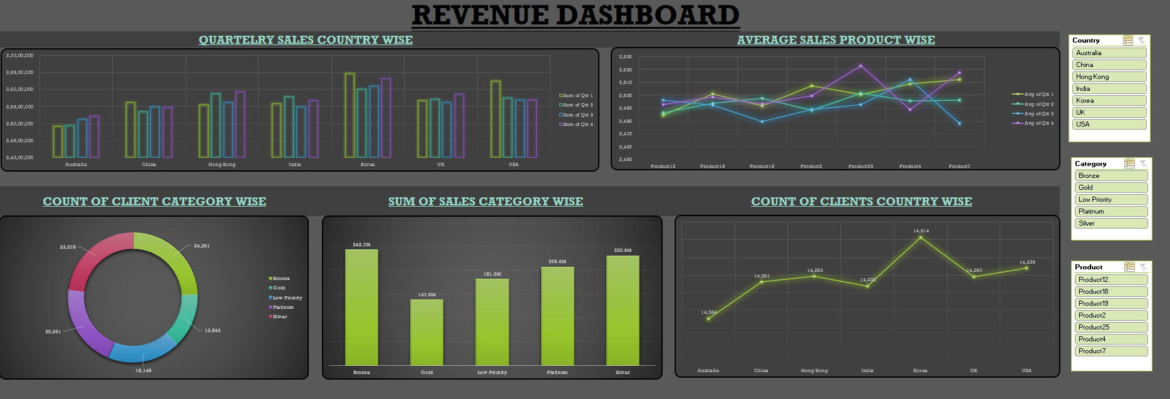
EXCEL DASHBOARD

Slide 9


